Slide 1
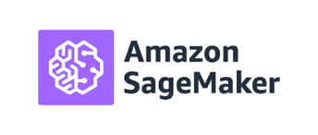
Data Analytics and Cloud Computing Series
Part 3
ML in AWS Sagemaker

Slide 2
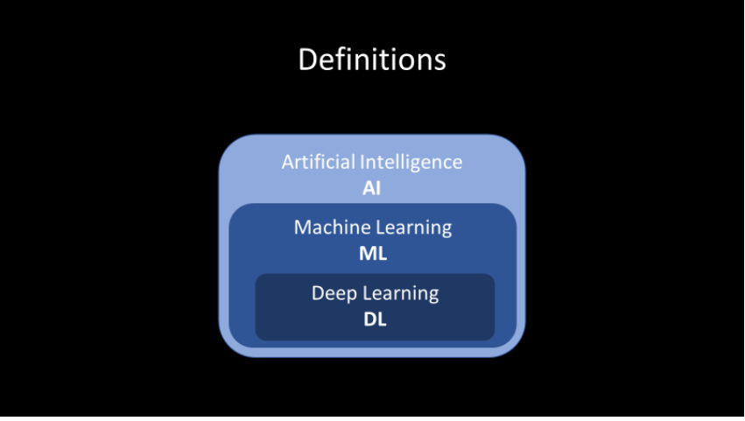
AI: techniques which enable machines to mimic human behavior: image recognition, speech recognition, etc.
ML: subset of AI using statistical methods to enable machines to learn from experience
DL: subset of ML which makes computation of multi-layer neural networks possible.

Slide 3
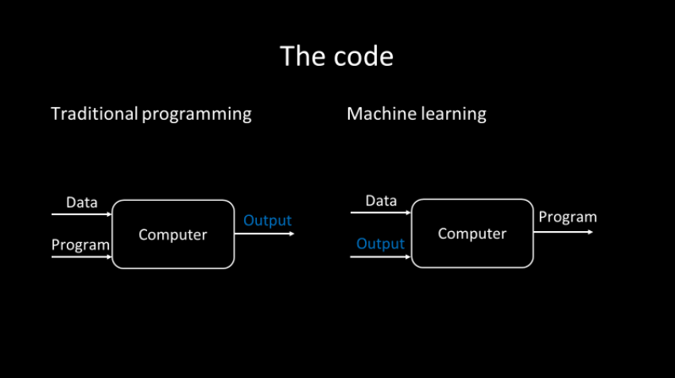
With traditional programming, the inputs are the data and the rules, written by a developer. These inputs give us a desired output, or the “right answer”.
With machine learning, inputs are the data and the output, or the “right answers” collected from the past experiences. These inputs combined, and put through the machine learning algorithm, give us a model — or a new algorithm that has learned the rules from the data. This way we get the desired rules without explicit programming.

Slide 4
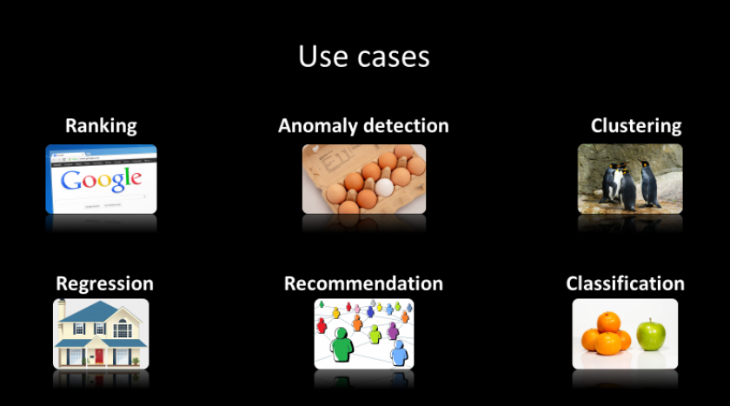
Use cases
Now that we know when to use machine learning, we can name some most common use cases. These are examples when machine learning works well, and it has been proven that in practice.
Ranking — is about finding the most relevant thing. Think about Google search for example.
Anomaly detection — is about spotting unusual things. Good examples for this use case are credit card fraud detection or preventive maintenance.
Clustering — is about grouping similar things together. Like for example customer segmentation.
Regression — is about predicting a numerical value of something. Here we can mention house price prediction as an example.
Recommendation — is about suggesting the most interesting thing. We have seen this many times in case of movie recommendation at Netflix for example.
Classification — is about finding what something is. Think about email spam filtering for example.

Slide 5
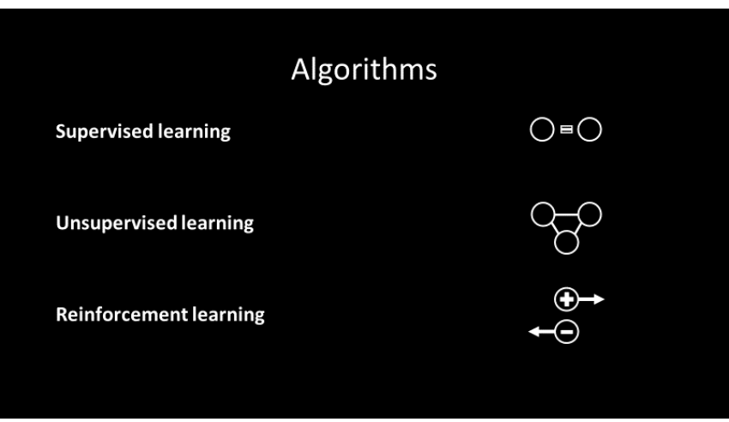
With supervised learning, the ”right answer” is known in advance. Program guesses the answer and compares it to the ”right answer” and learns from experience. With unsupervised, there is no ”right answer”. Program searches for patterns, clusters and anomalies in the data. And with reinforcement learning, the program tries to find the most efficient path to the goal. Success gives a reward — failure produces a restart.

Slide 6
Machine learning life cycle
How is Machine learning usually done? It always starts with the raw, unrefined data. We have to get the data, clean it, reshape it and transform it. Then we have to perform statistical analysis and exploration to find hidden relations inside the data. These insights help us to find relevant features and filter out the other ones, that do not offer any value for the problem we are solving. This is what we call the build step.
This nicely shaped data is what we call “train data”. This data is then being used to experiment with different machine learning models until we find the one that gives us the best result. This is achieved through a long process of model evaluation and hyper parameter optimization. This is a train step of the machine learning life cycle.
Finally, when our favourite model is ready, it can be used to power some service or an application and has to be deployed. After that its performance gets evaluated to see if it works according to expectations. The data we collect from monitoring it and as a result of its functioning, can be used further to improve model even more. This is a deploy step of the process

Slide 7
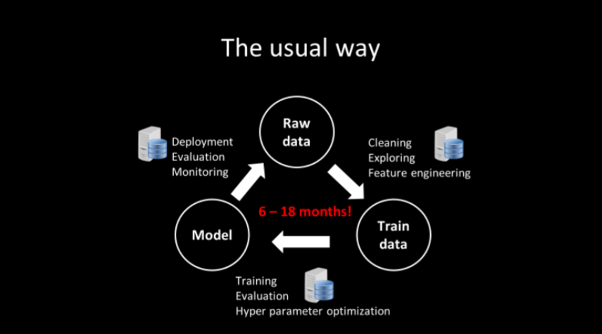
For each of the steps: build, train, deploy — we need a server or a cluster, depending on the requirement and a problem. Purchasing hardware, installing an operating required software and tying everything together — can be a big challenge.
The extent of this challenge depends on some important factors like company organisation, culture, technological level, skill level etc. All these factors can slow down Machine learning life cycle significantly.
Most common problems are: data scientists do not have access to the data, or they do not have sufficient computing resources. Developers do not have machine learning knowledge, and data scientists do not have good software engineering skills. Due to gap among these teams, hand-over and deployment of machine learning models in production is very slow and painful.

Slide 8
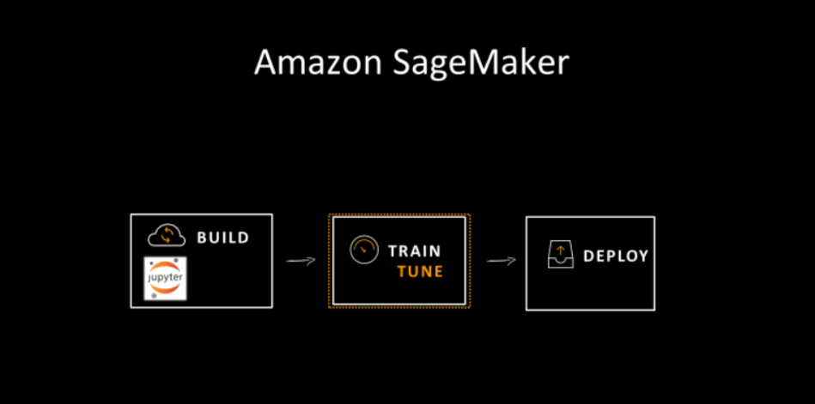
By now you must be wondering is there a better way? Luckily — there is! And that is why start talking about AWS SageMaker.
AWS SageMaker
This Amazon cloud service was created with only one idea in mind: to put machine learning into the hands of every developer, regardless of their knowledge of that area. It provides easy, fast and scalable way to perform all three usual steps: build, train and deploy.

Slide 9
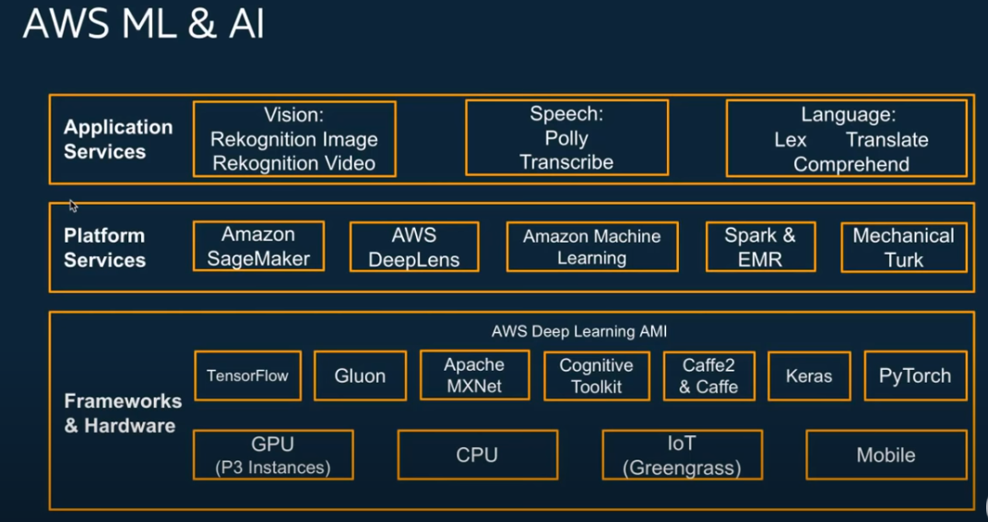

Slide 10
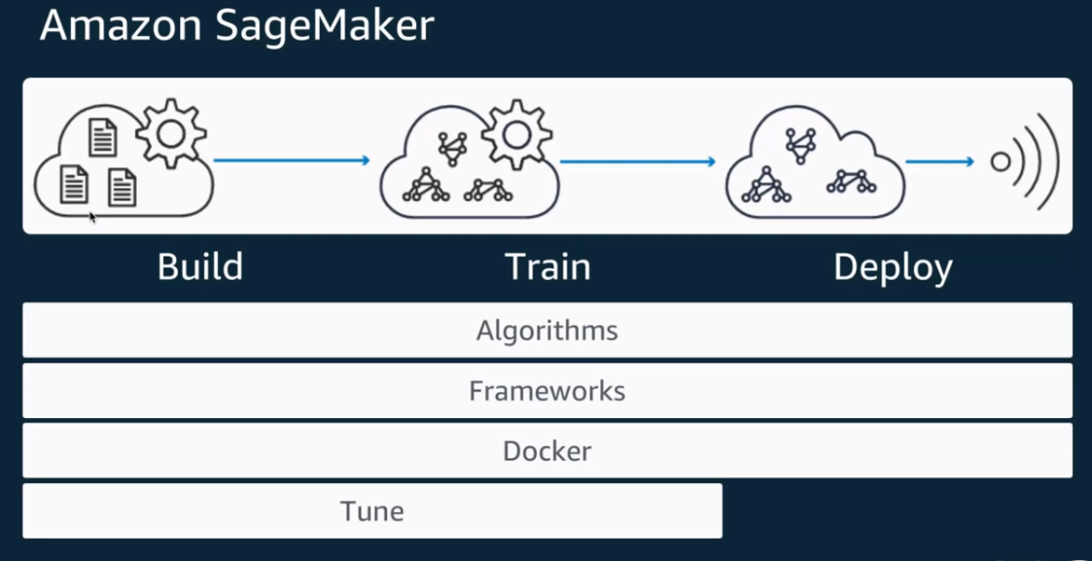

Slide 11
Build
We can create Jupyter notebook instance with desirable server size and capacity, with just a few clicks. When Jupyter hub is running, the data cleaning and exploration can begin. The best feature here is the ability to choose desired server size for our notebook instance. We can also automate shut down of the instance after some period of inactivity and avoid unnecessary costs.
Train
We can train our models on the right server capacity with the ability to choose the size and number of servers to train on. Starting a server is just one line of code and the server will shut down automatically after the training of a model is complete.
Deploy
Here again we can deploy our Machine learning model with just one line of code, by specifying desired server capacity. Use the endpoint address to create the application service or serverless function.

Slide 12
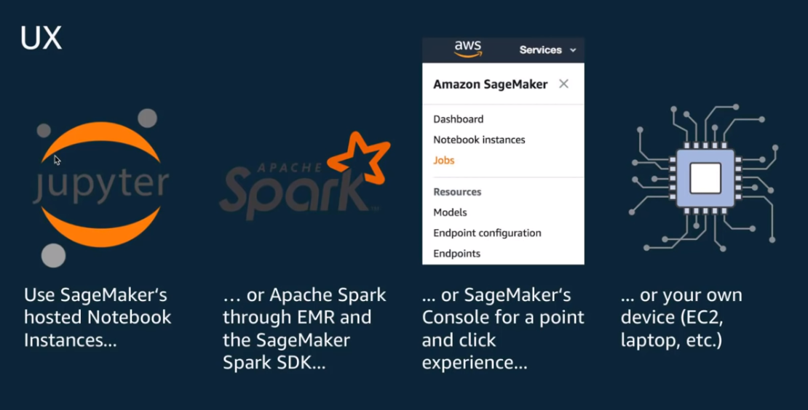

Slide 13
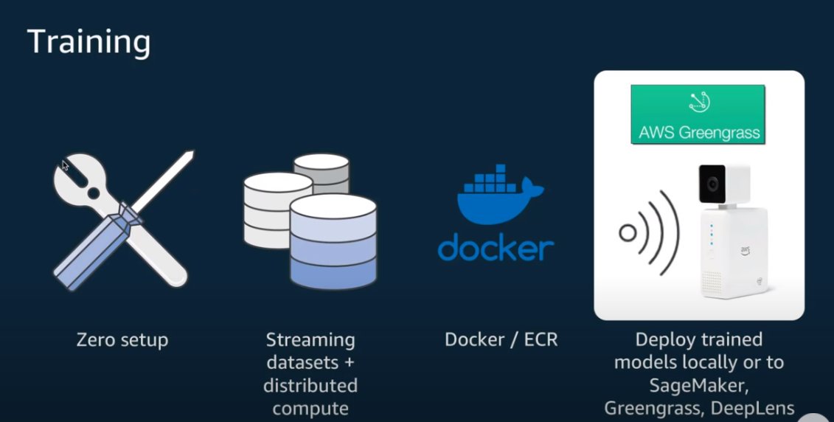

Slide 14
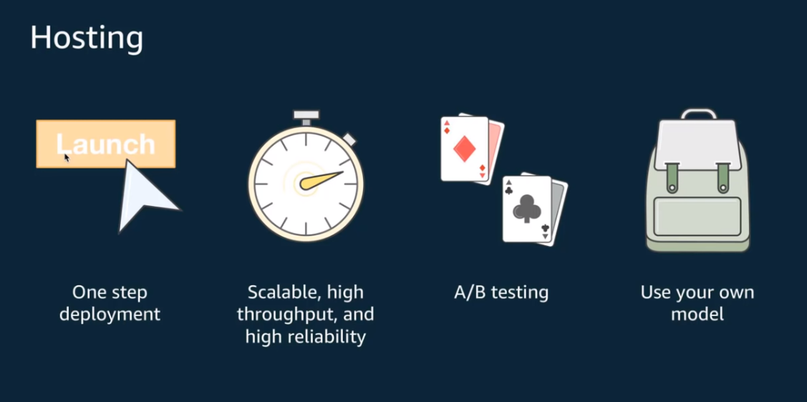

Slide 15
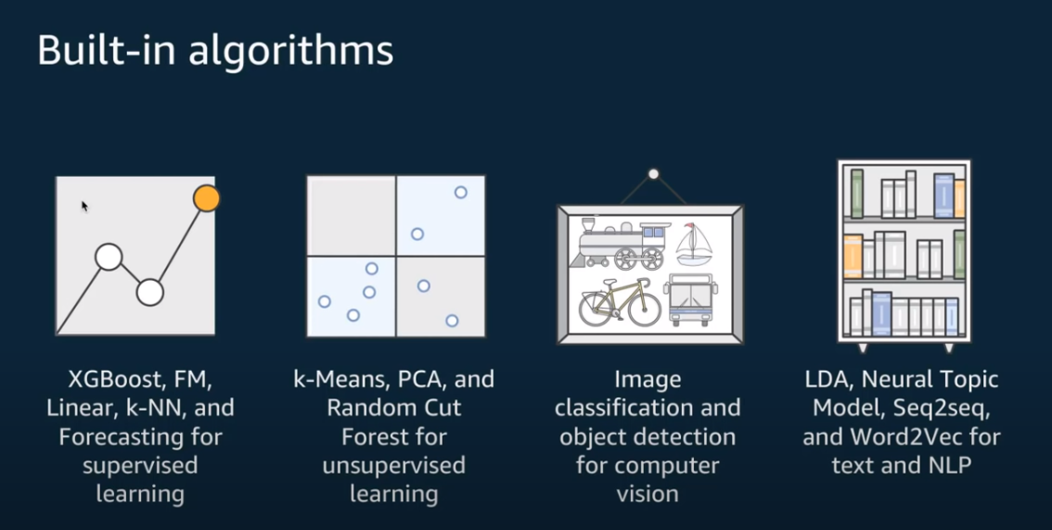

Slide 16
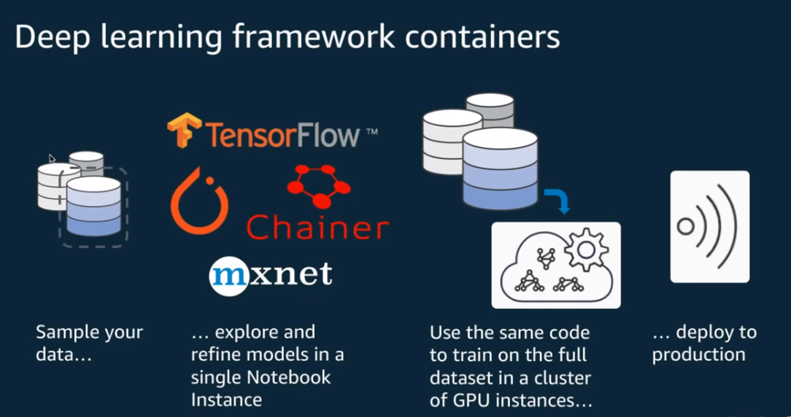

Slide 17
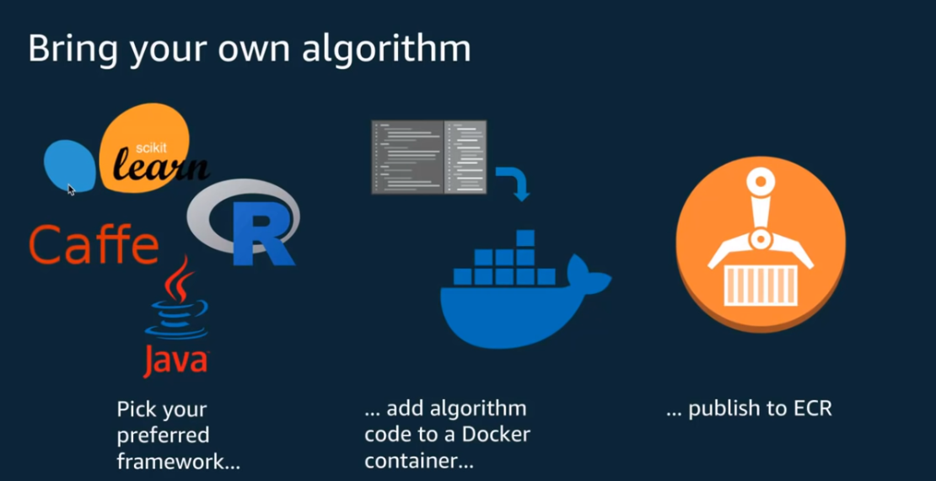

Slide 18
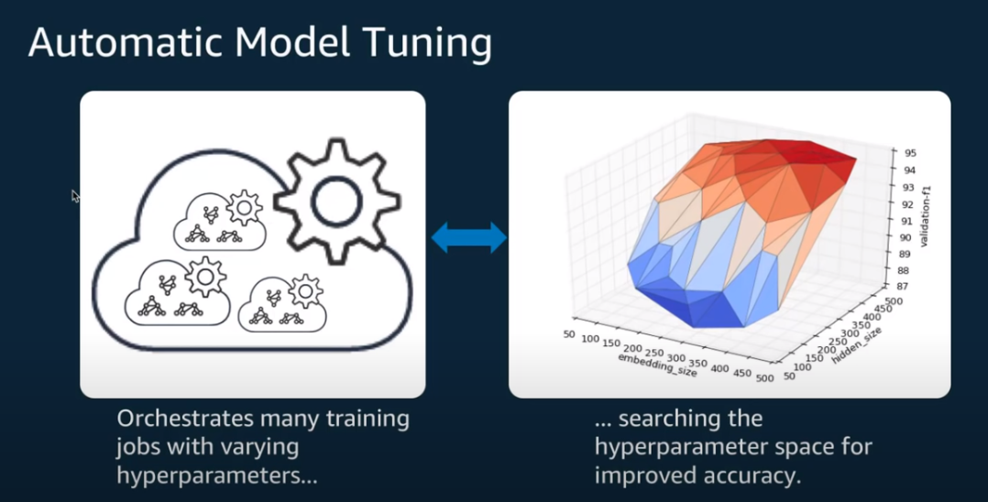

Slide 19
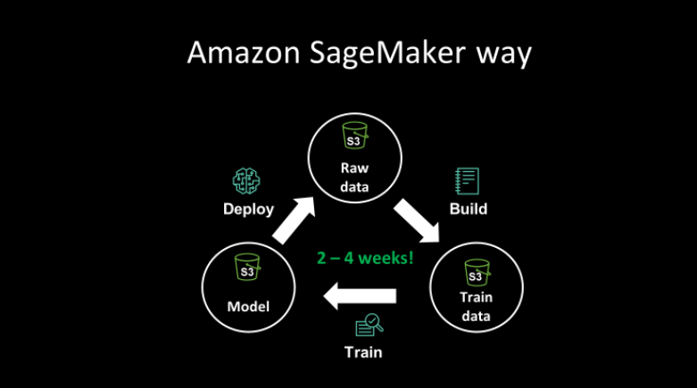
Machine learning AWS SageMaker way
SageMaker gives us the ability to develop and deploy our machine learning models in a matter of days or weeks instead of months or years! It achieves that by easy provisioning of resources for data clean up and exploration, and seamless way to provision and scale server endpoints for deployment of machine learning models.

